Slide 1
PSCS_49_Al-based tool for preliminary diagnosis of Dermatological manifestations
CSE7101- Capstone Project
Review-2
Batch Number: 2022
Roll Number | Student Name
20221CAI0037 20221CAI0048 20221CAI0008 | Armaan Khan Syed Basim Shaik Mahammed Saif
Under the Supervision of,
Mr. Jai Kumar B
Assistant Professor
School of Computer Science and Engineering
Presidency University
Name of the Program: CAI-Computer Science & Engineering (Artificial Intelligence & Machine Learning)
Name of the HoD: Dr. Zafar Ali Khan N
Name of the Program Project Coordinator: Ms. Suma N G
Name of the School Project Coordinators: Dr. Sampath A K , Dr. Geetha A

Slide 2
Abstract
Skin diseases are among the most common health issues worldwide, but timely diagnosis is often limited due to shortage of dermatologists and lack of access to specialized care. This project proposes an AI-based tool that enables preliminary diagnosis of dermatological manifestations using deep learning models trained on dermatoscopic and clinical skin images. The system assists patients and healthcare workers by identifying possible conditions and providing recommendations for further consultation. The approach integrates Convolutional Neural Networks (CNNs), transfer learning, and explainable AI techniques, ensuring robust classification and interpretable predictions. This solution aims to provide low-cost, accessible, and scalable healthcare support in dermatology.

Slide 3
Literature Survey (10 Papers Reviewed)
Artificial Intelligence in Skin Cancer Diagnosis: A Reality Check (2023)
Skin cancer detection using deep machine learning techniques (2024)
AI-Powered Diagnosis of Skin Cancer: A Contemporary Review, Open Challenges and Future Research Directions (2023)
Review on Automated Skin Cancer Detection Using Image Processing Techniques(2023)
Enhanced skin cancer diagnosis: a deep feature extraction-based framework for the multi-classification of skin cancer utilizing dermoscopy images (2024)
Artificial intelligence for skin cancer detection and classification for clinical environment: a systematic review(2024)
Detection of Skin Cancer Based on Skin Lesion Images Using Deep Learning(2022)
Skin cancer detection using multi-scale deep learning and transfer learning(2023)
A precise model for skin cancer diagnosis using hybrid U‑Net and improved MobileNet‑V3 with hyperparameters optimization(2024)
Boosting skin cancer diagnosis accuracy with ensemble approach(2025)
A robust deep learning framework for multiclass skin cancer classification(2025)

Slide 4
Objectives
1. Develop Deep Learning-Based Tool
  Build a reliable AI model for accurate skin disease classification.
  Achieve dermatologist-level performance using CNN/Transformer models.
2. Enable Preliminary Diagnosis
  Support multi-class & multi-label classification.
  Assist in identifying conditions requiring urgent medical care.
3. Ensure Scalability Across Skin Tones
  Train with diverse datasets (age, ethnicity, lighting).
  Adaptable to new datasets for real-world usage.
4. Integrate Explainable AI
  Use Grad-CAM, LIME, SHAP for visual explanations.
  Improve trust, transparency, and clinical acceptance.
5. Provide User-Friendly Interfaces
  Web portal for doctors & mobile app for patients.
  Features: image upload, instant results, explanations, secure sharing.

Slide 5
Existing Methods and Drawbacks
1. Traditional Image Processing
Method: Manual feature extraction (texture, color, shape).
Drawback: Limited accuracy, high dependency on handcrafted features.
2. CNN-based Models (ResNet, EfficientNet, Inception)
  Method: Deep convolutional networks trained on dermatology datasets.
  Strength: High accuracy for disease classification.
  Drawback: Require very large and diverse labeled datasets to generalize well.
3. Federated Learning Models
  Method: Distributed training across multiple devices/institutions without data sharing.
  Strength: Protects patient privacy and enables multi-institutional learning.
  Drawback: Computationally heavy and difficult to implement in real-world clinical settings.
  General Limitations
  Lack of Generalizability: Models trained on specific datasets may not work across demographics, skin tones, or environments.
  Data Dependency: Success depends heavily on large labeled datasets, which are costly and time-consuming to curate.

Slide 6
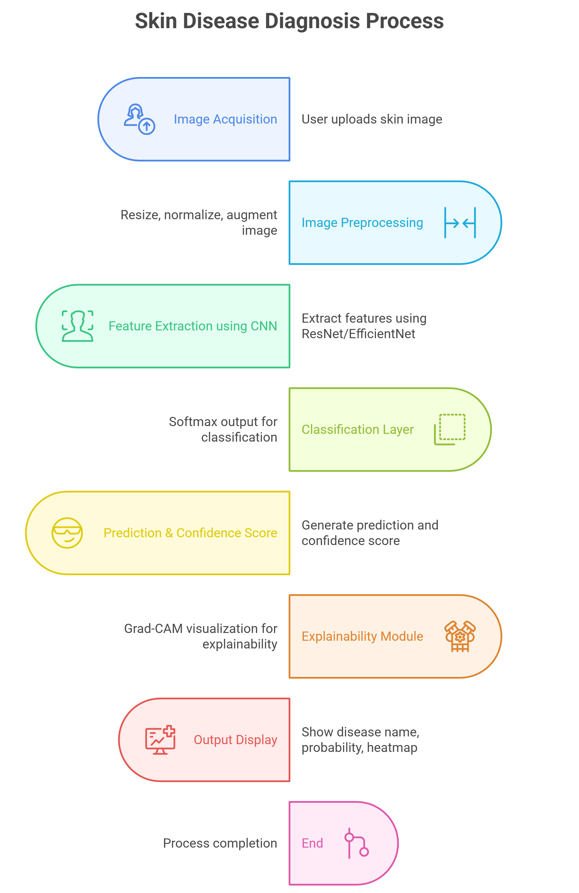
Architecture Diagram
.

Slide 7
References
1. Artificial Intelligence in Skin Cancer Diagnosis: A Reality Check Gabriella Brancaccio1 , Anna Balato1 , Josep Malvehy2,3 , Susana Puig2,3 , Giuseppe Argenziano1 and Harald Kittler4
2. Skin cancer detection using deep machine learning techniques Olusoji Akinrinade * , Chunglin Du
3. AI-Powered Diagnosis of Skin Cancer: A Contemporary Review, Open Challenges and Future Research Directions
4. Review on Automated Skin Cancer Detection Using Image Processing Techniques Haniye Jafari1 , Mojtaba Esmailpour Roshan2
5. Enhanced skin cancer diagnosis: a deep feature extraction-based framework for the multi-classification of skin cancer utilizing dermoscopy images
6. Artificial intelligence for skin cancer detection and classification for clinical environment: a systematic review
7. Detection of Skin Cancer Based on Skin Lesion Images Using Deep Learning Walaa Gouda 1,2,* , Najm Us Sama 3 , Ghada Al-Waakid 4 , Mamoona Humayun 5,* and Noor Zaman Jhanjhi 6
8. Skin cancer detection using multi-scale deep learning and transfer learning
9. A precise model for skin cancer diagnosis using hybrid U‑Net and improved MobileNet‑V3 with hyperparameters optimization
10. Boosting skin cancer diagnosis accuracy with ensemble approach
11. A robust deep learning framework for multiclass skin cancer classification

Slide 8


